Slide 1
Data analysis and visualization (CS306) lab

Slide 2
Lab 9
For all the experiments, you will need to submit a pdf file that should include
all plots/images/figures
the analysis as part of your answer to questions
your code/script
All plots/figures should be labeled properly (x-axis, y-axis, title etc.)
You can use Matlab/Python for programming

Slide 3
Lab 9
Objectives:
To draw statistical inferences on given data, and compare parametric and nonparametric methods

Slide 4
Lab 9: Exp1
Load data_lab9.mat. The vectors ‘new’ and ‘traditional’ represent the degree of reading power (DRP) scores for two groups of students who followed a new reading method and the traditional method (higher DRP implies better reading power). Your goal is to answer if the new reading method improves reading ability of elementary school students (as compared to traditional method), as measured by DRP scores. Your analysis may also include a comparison of parametric and non-parametric tests.

Slide 5
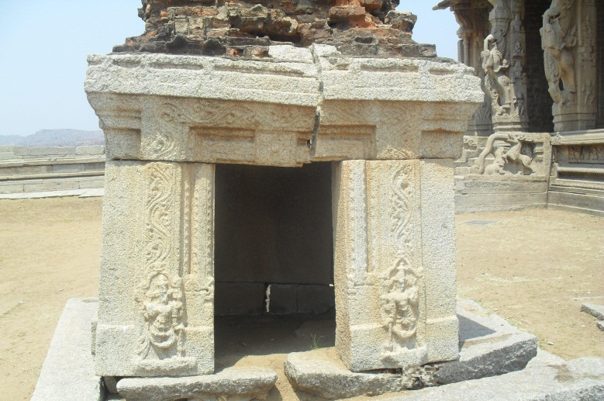
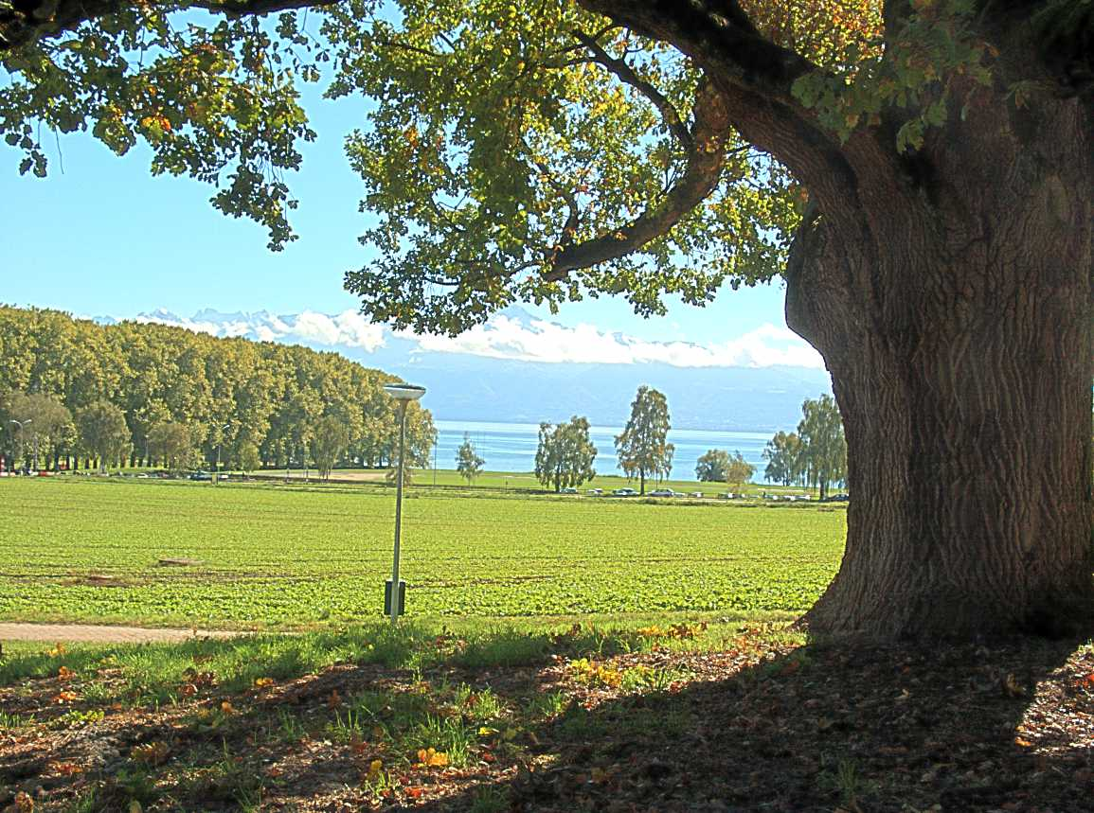
Lab 9: Exp2
Development of content specific methods is important but challenging in several video processing applications. One such example is that of heritage and natural content. Heritage content represents specific type of data which is different from natural scene data. We can quantify this in terms of color. Heritage images in general have lower color because the structures represented in them are old and tend to be less colorful.

Slide 6
Lab 9: Exp2
Load data_lab9.mat. The vectors ‘natural’ and ‘heritage’ represent color values of natural and heritage pictures. You need to analyze this data, and answer if natural content is different from heritage content in terms of the color measure. Your analysis should be end-to-end (justify any choices that you make: choice of test statistic, parametric or nonparametric, effect of sample size etc.).

Slide 7
Lab 9: submission
Submit a single pdf file (per group) on Moodle
Deadline: 11/04/2017 (9 pm)

